Slide 1
SWAN- SMT Stencil Verify Review
JBD-VN-ME
2022/01/15

Slide 2
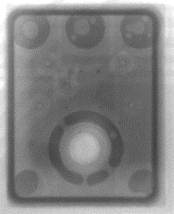
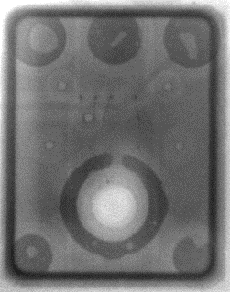
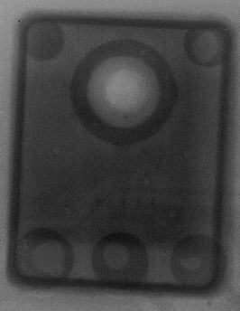
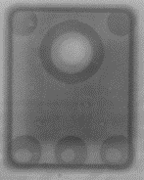
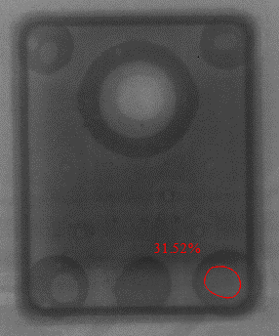
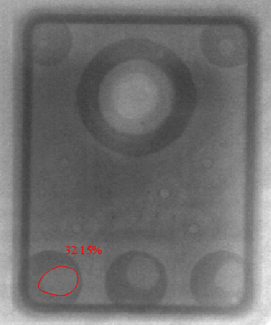
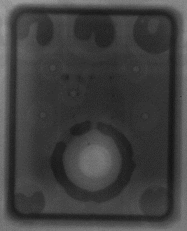
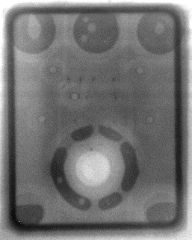
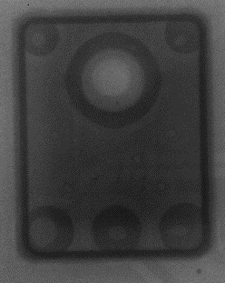
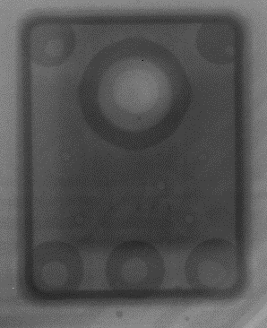
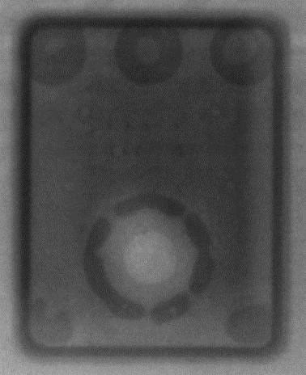
96.1516T00- SMT Stencil Verify
1.Online Stencil thickness 0.09 (mm)+used normal solder paste (KOKI _S3X58 M500)
Checking X-RAY 50 pcs: Some MIC parts were defect:
Solder void:2/200 (1%)
Solder ball :4/200 (2%)
O-Ring issue:5/200 (2.5%)
Solder void defect
Solder ball defect
O-Ring issue
Summary:
With this verify method, we detect a high defect rate as above.
With Stencil thickness 0.09 mm get more O-Ring issue.

Slide 3
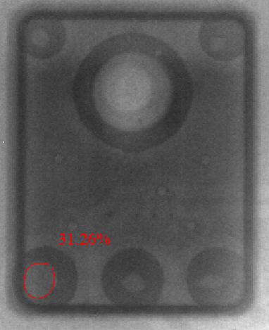
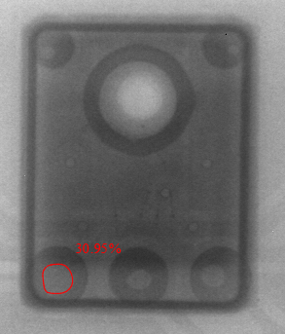
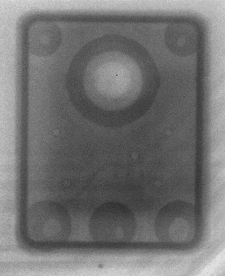
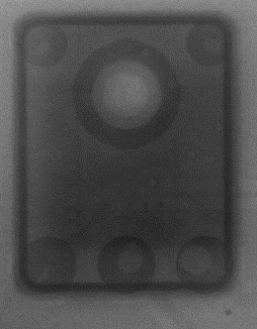
96.1516T00- SMT Stencil Verify
2.Online Stencil thickness 0.10 (mm) +used normal solder paste (KOKI _S3X58 M500)
Checking X-RAY 50 pcs: Some MIC parts were defect:
Solder void:2/200 (1%)
Solder ball :2/200 (1%)
O-Ring issue:0/200 (0%)
Solder void defect
Solder ball defect
Summary:
- Based on this verify method, we detect a low defect rate as above.
- A stencil thickness of 0.10 mm receives better results than a Stencil thickness of 0.09 mm. The special O ring without sealing does not occur any defects.

Slide 4
96.1516T00- SMT Stencil Verify
Conclusion:
With used stencil thicknesses of 0.09 (mm) and 0.10 (mm), we still have an abnormal problem that accounts for about 1%~3%. Mostly the problem is void solder and solder ball.
Based on verification, we found that with the stencil thickness in use, there is a better pass rate, especially with O-ring without sealing errors. (with a thickness of 0.10 mm)
With abnormalities arising, all are passed at functional test stations. We need RD verify and improvement test program to coverage this issue.
Status | Online Stencil 0.09 mm |  |  | Online Stencil 0.10 mm
 | Fail Q'Ty | Total | Defect rate | Fail Q 'Ty | Total | Defect rate
Void solder >30% | 2 | 200 | 1.00% | 2 | 200 | 1.00%
Solder ball | 4 | 200 | 2.00% | 2 | 200 | 1.00%
O-ring not seal | 5 | 200 | 2.50% | 0 | 200 | 0.00%

